Slide 1
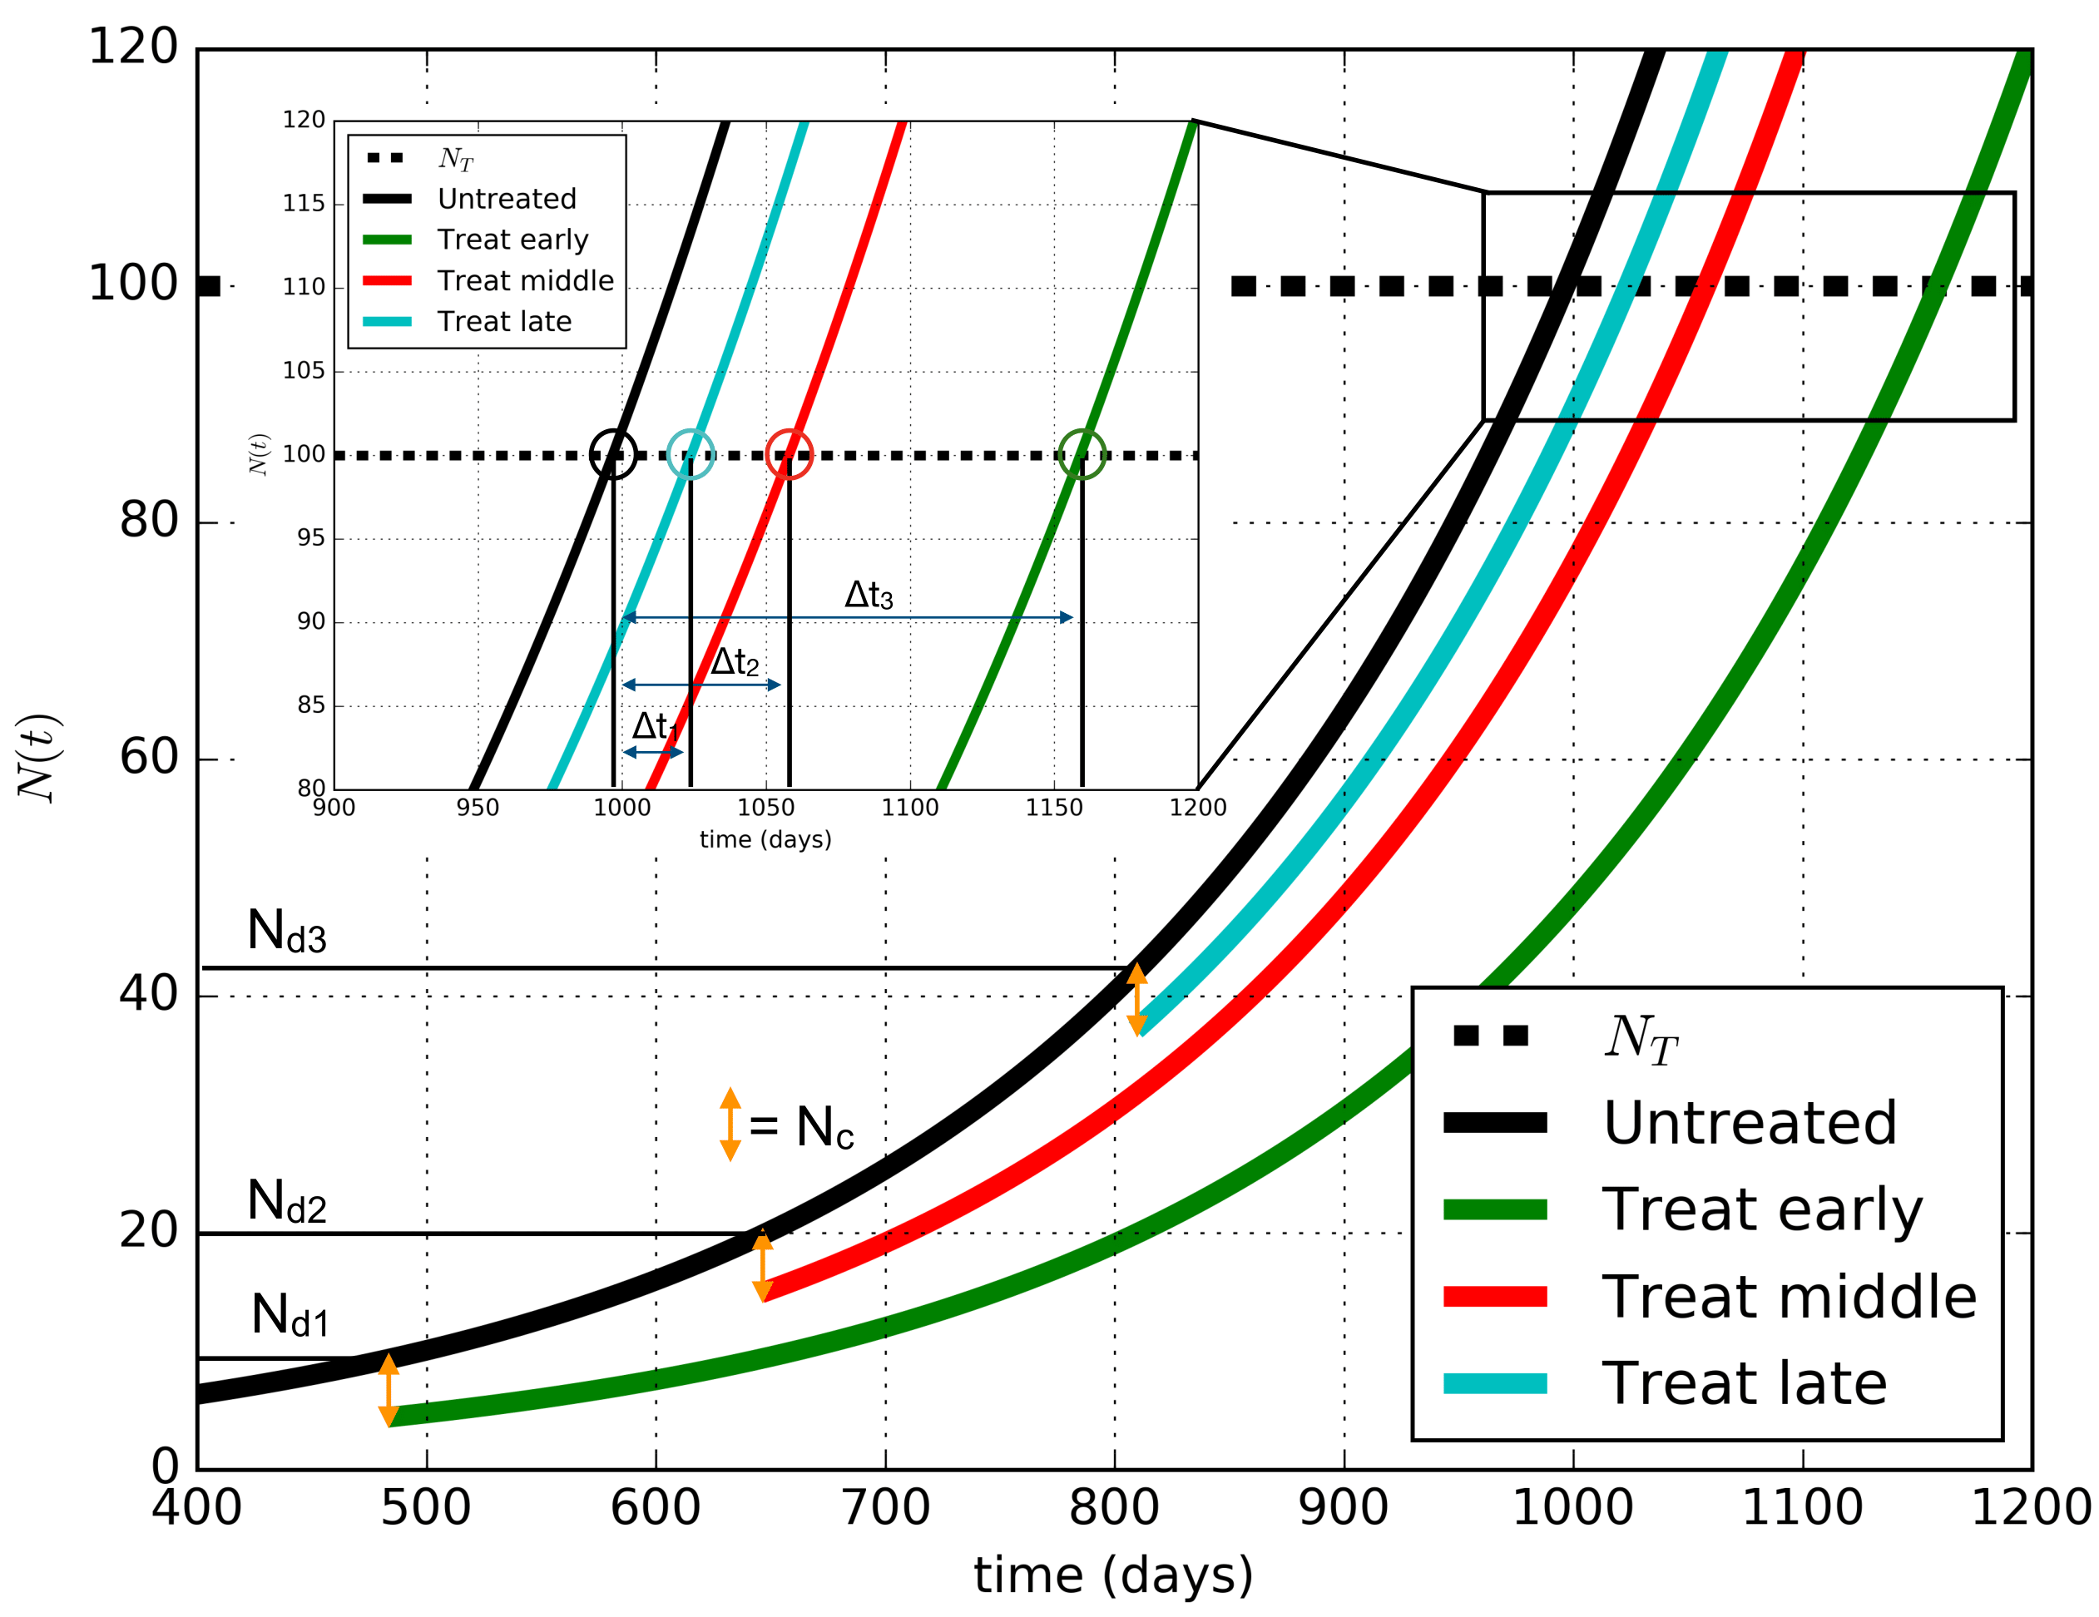


Slide 2
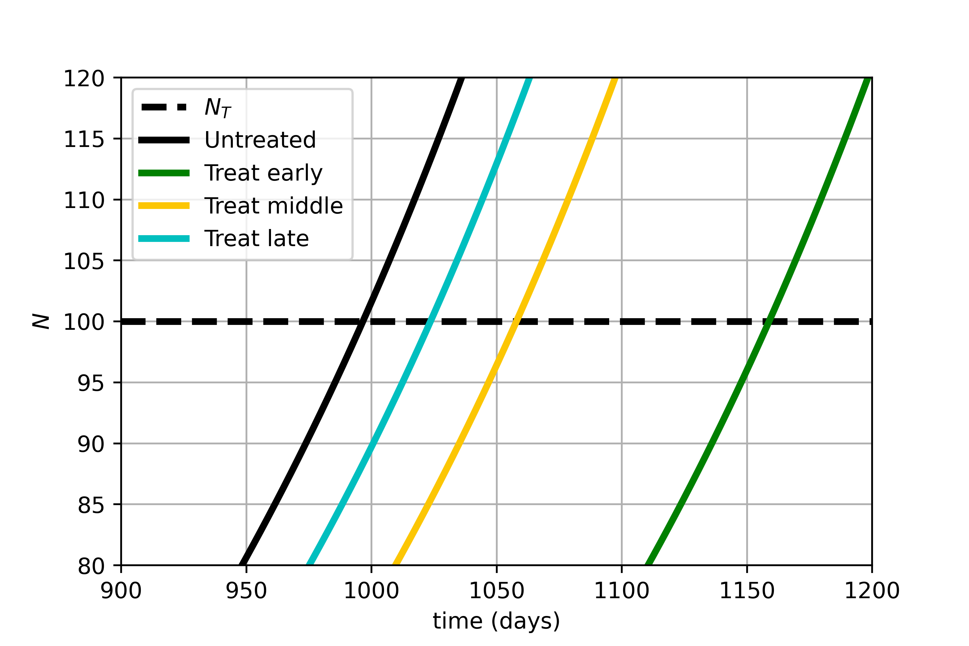
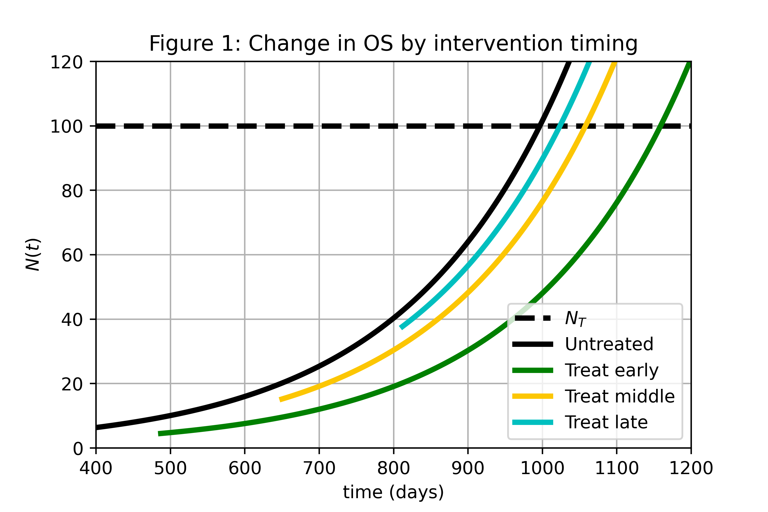
Δt₃
Δt₂
Δt₁
N_{d3}
N_{d2}
= N_{c}
N_{d1}

Slide 3
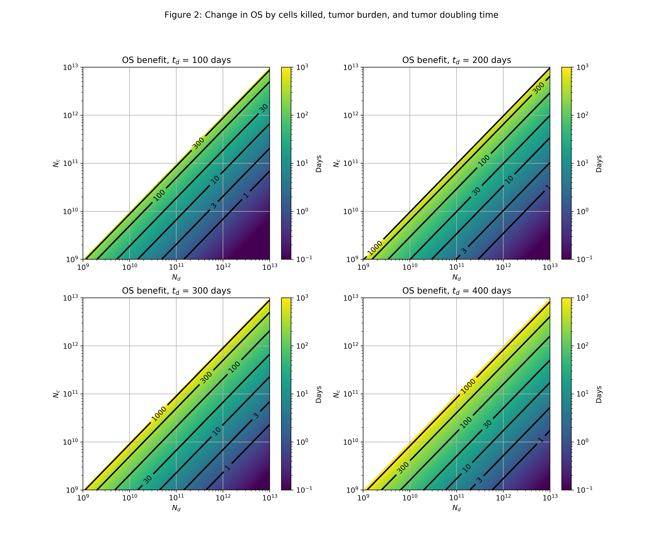

Slide 4
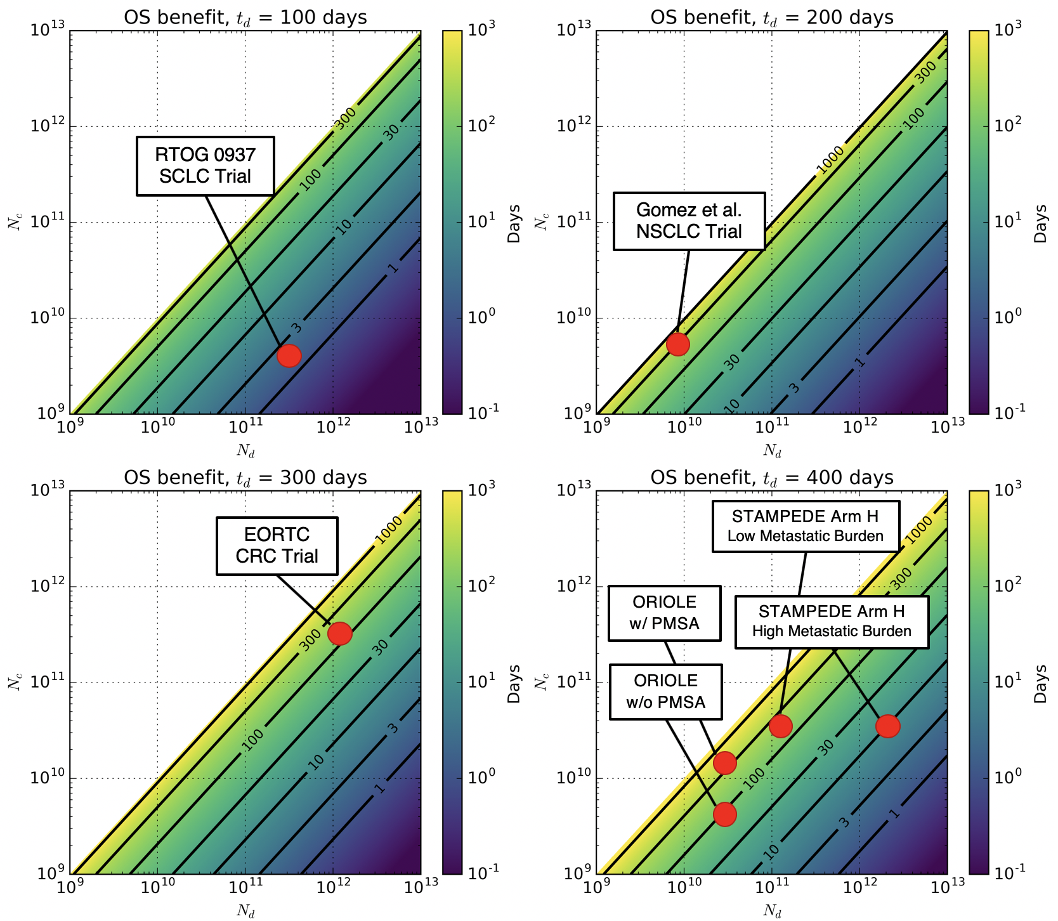

Slide 5
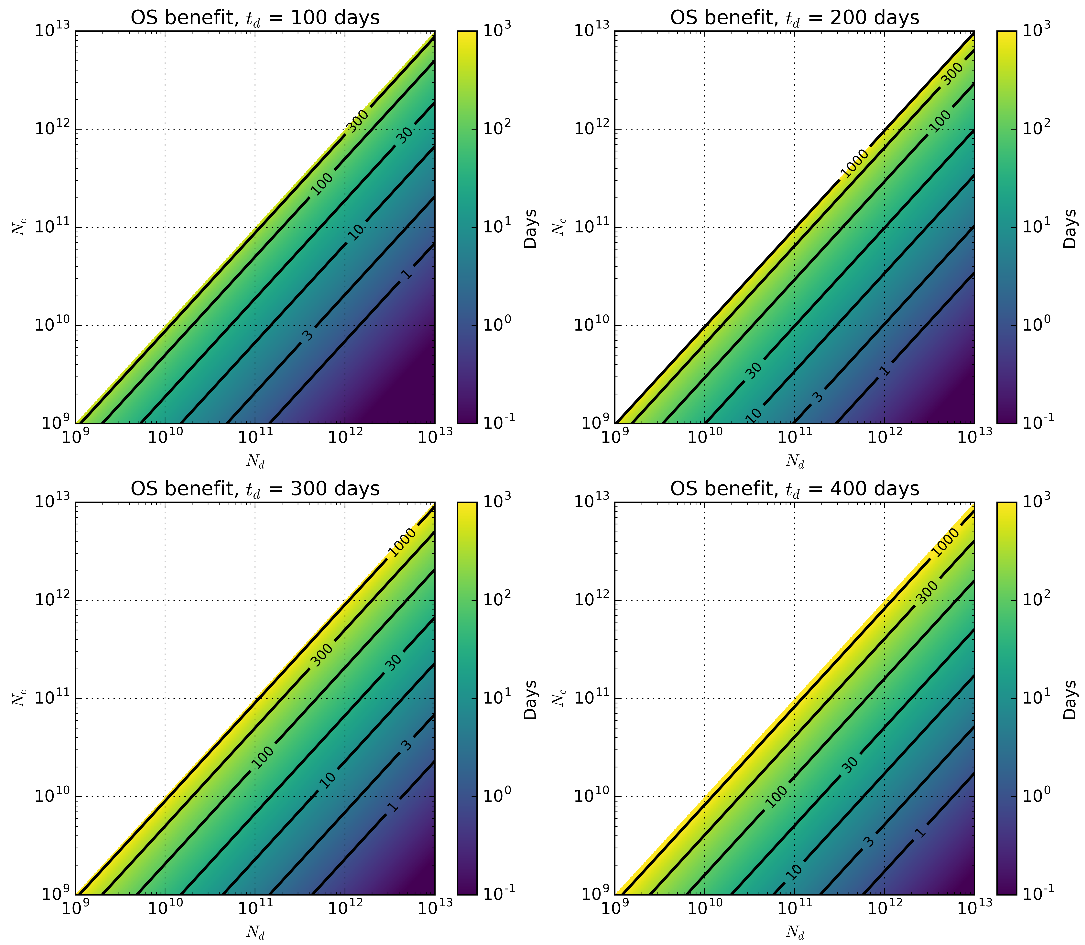
RTOG 0937 SCLC Trial
Gomez et al. NSCLC Trial
EORTC CRC Trial
STAMPEDE Arm H
Low Metastatic Burden
ORIOLE
w/ PMSA
STAMPEDE Arm H
High Metastatic Burden
ORIOLE w/o PMSA

Slide 6
RTOG 0937 SCLC Trial
ORIOLE
w/ PMSA
STAMPEDE Arm H
Low Metastatic Burden
ORIOLE w/o PMSA
STAMPEDE Arm H
High Metastatic Burden

Slide 7
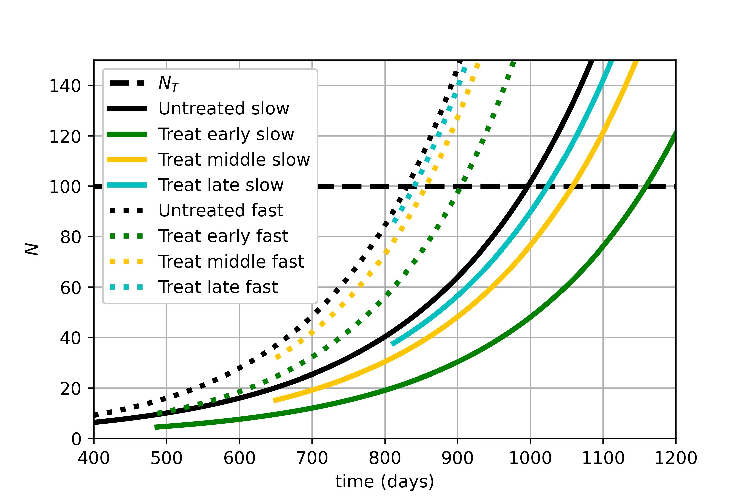
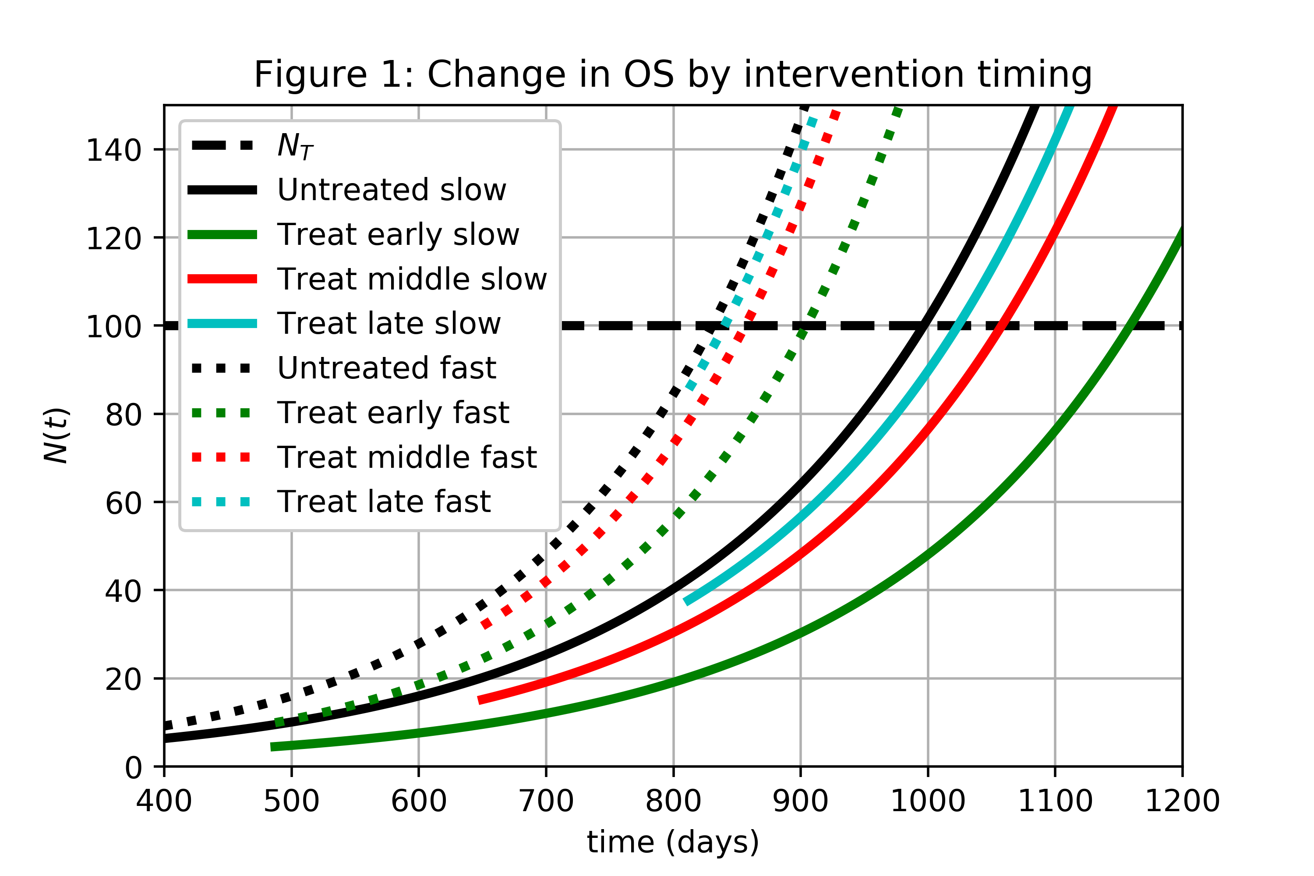
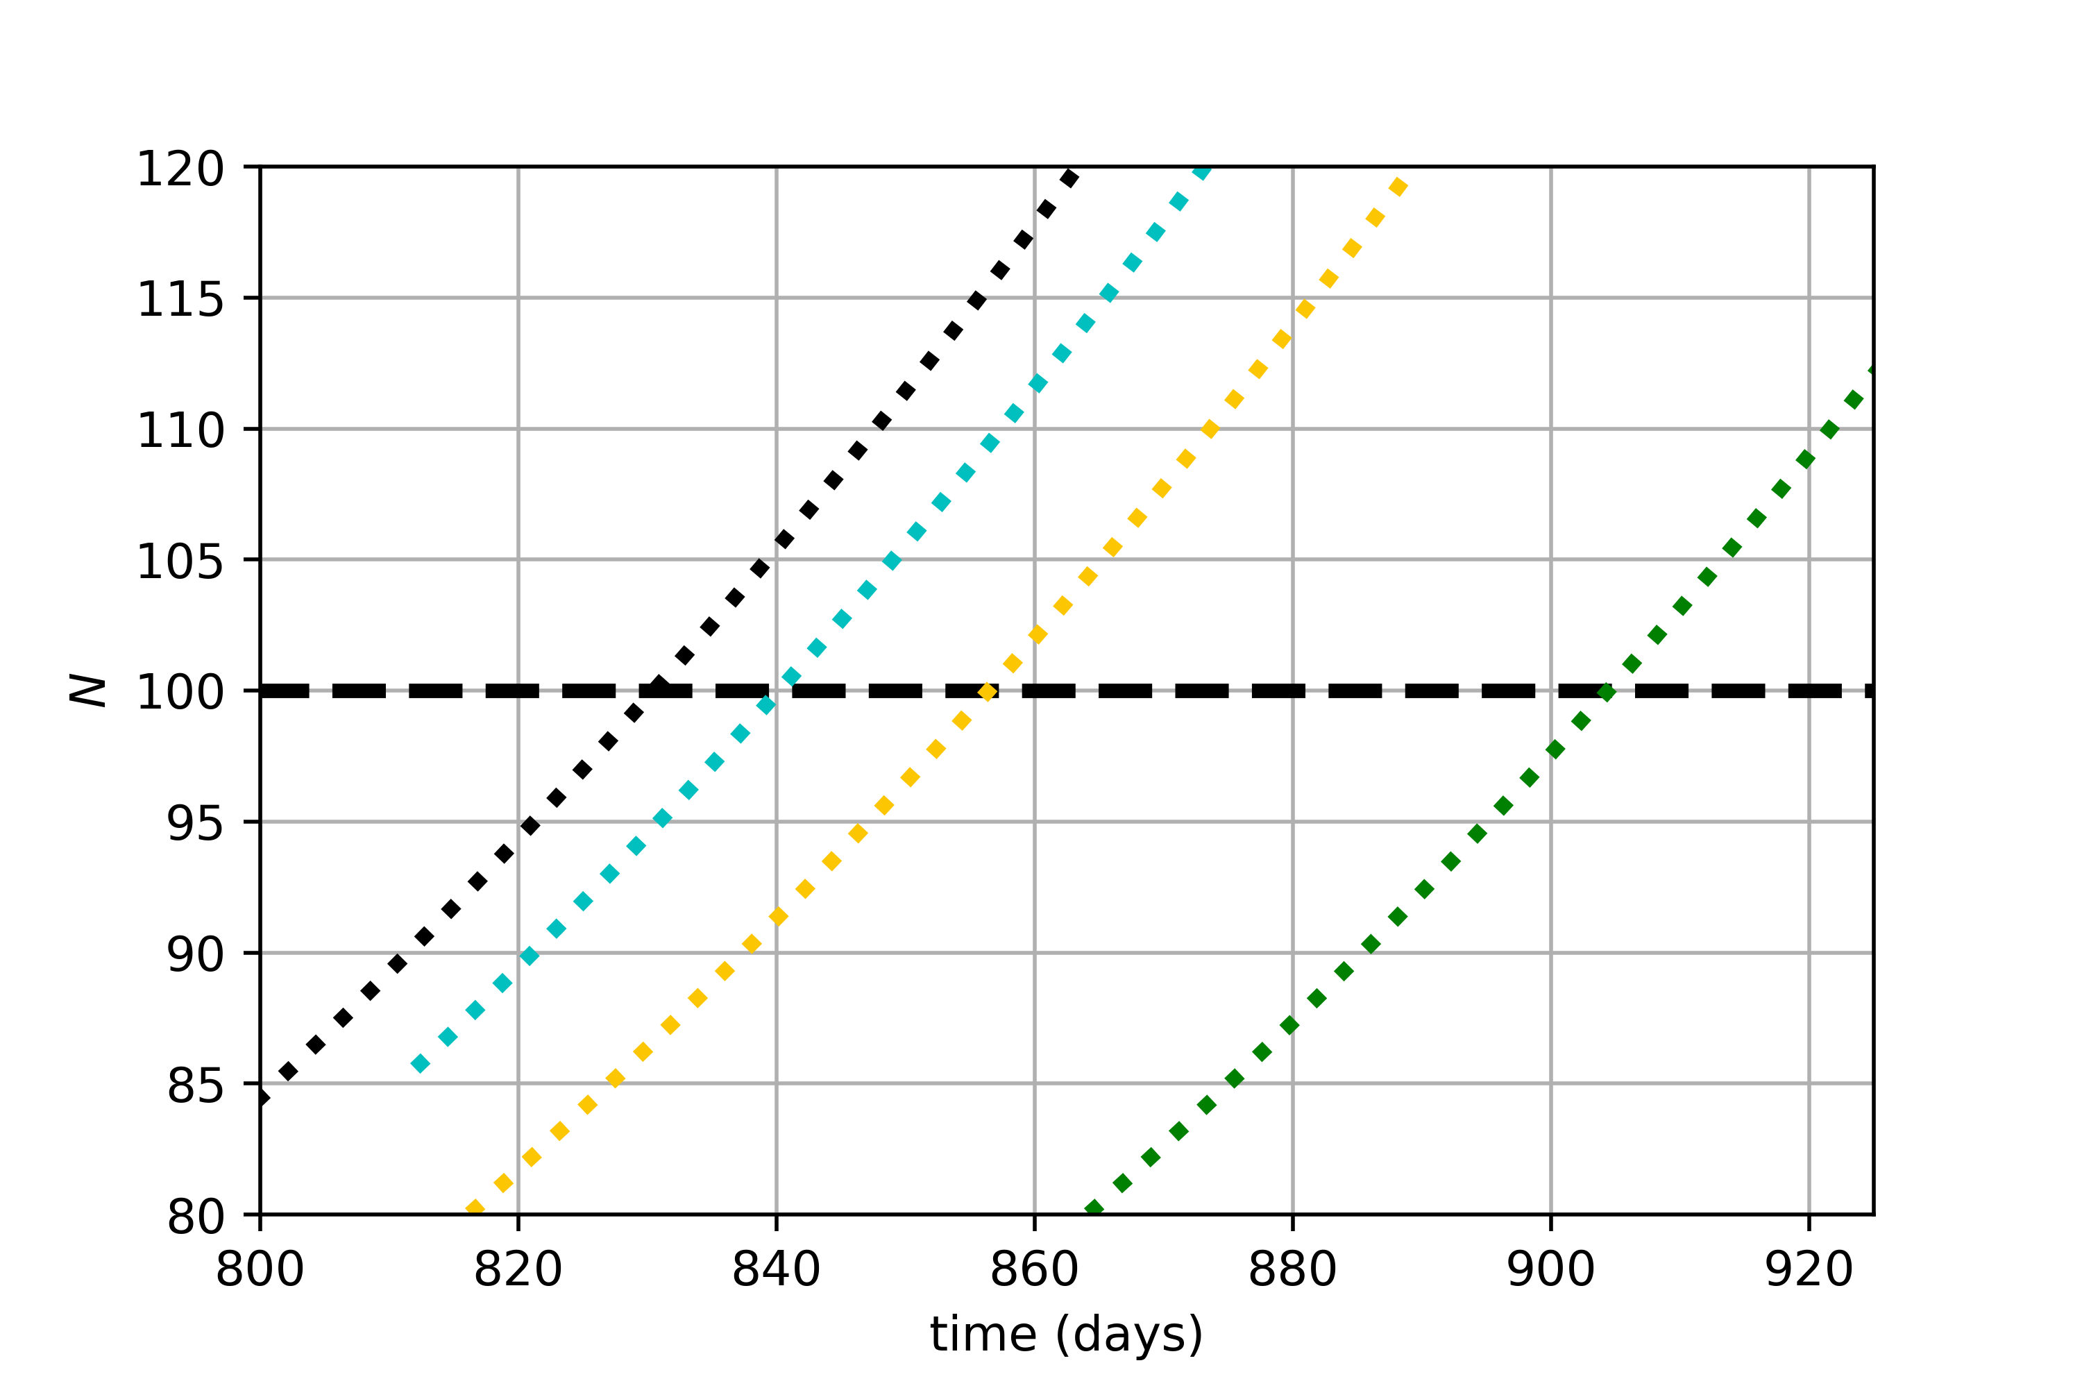
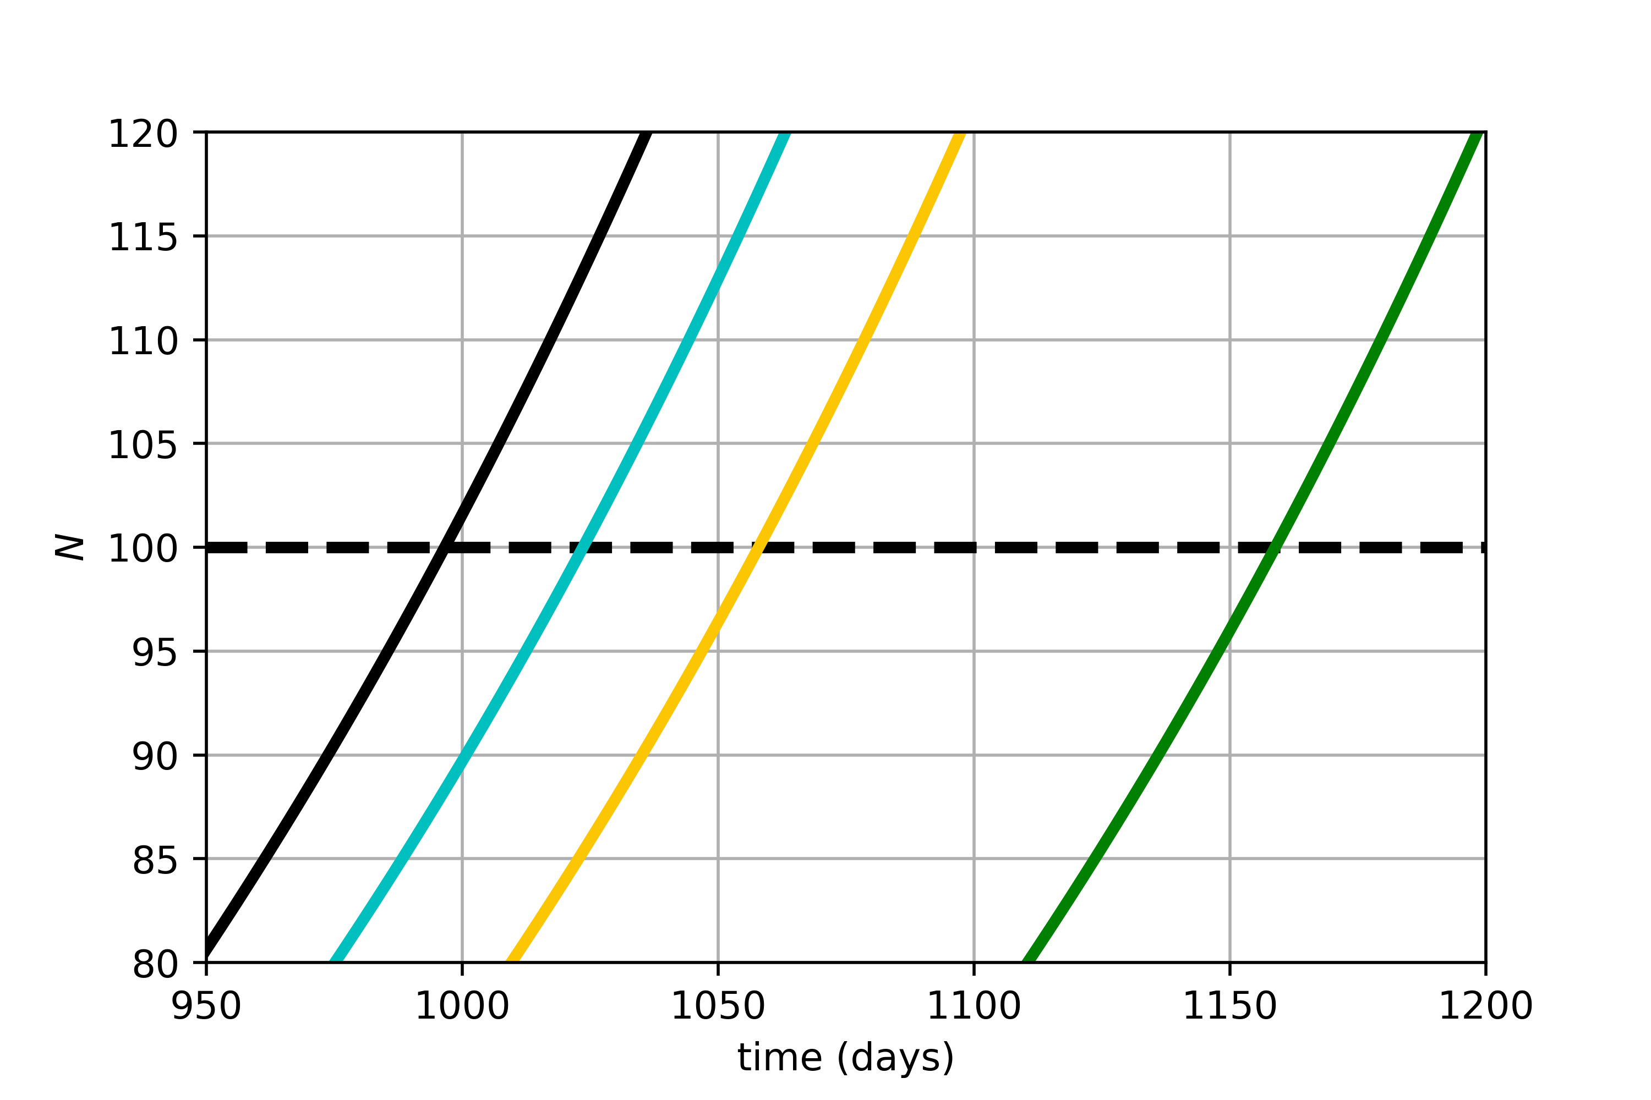
Δtf₃
Δts₃
Δtf₂
Δts₂
Δtf₁
Δts₁

Slide 8
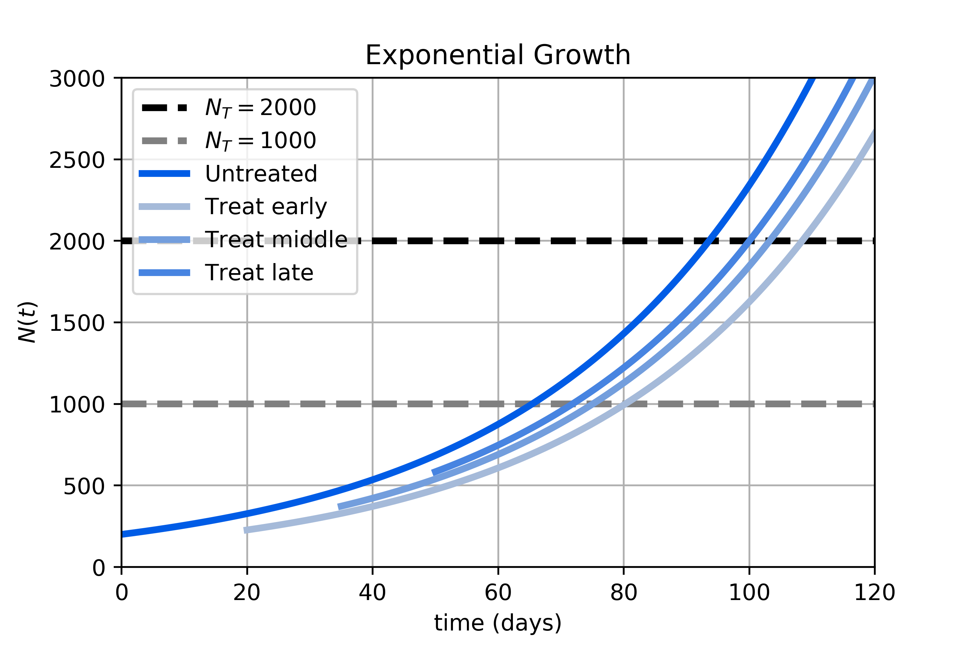
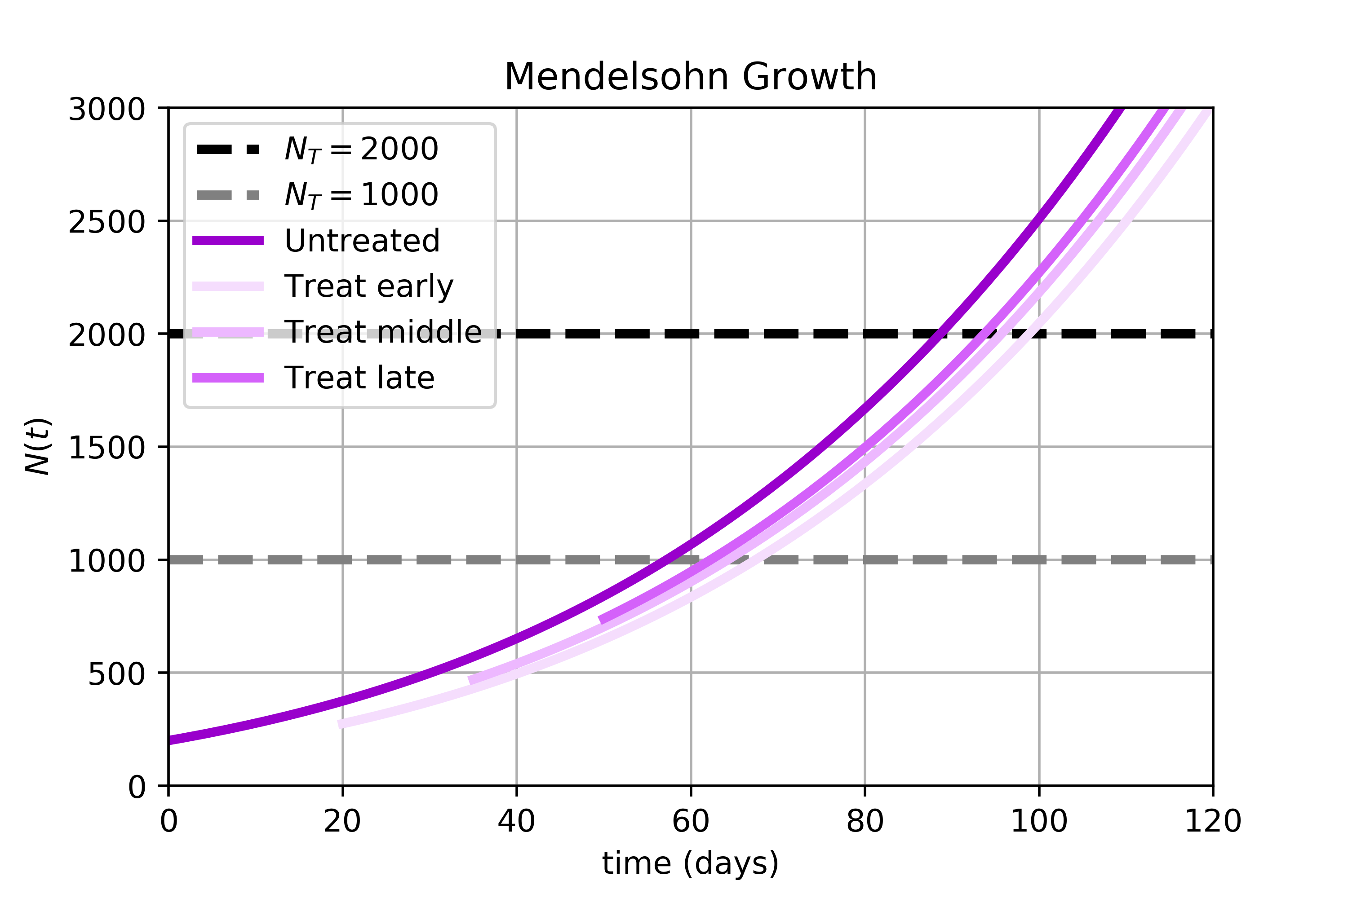
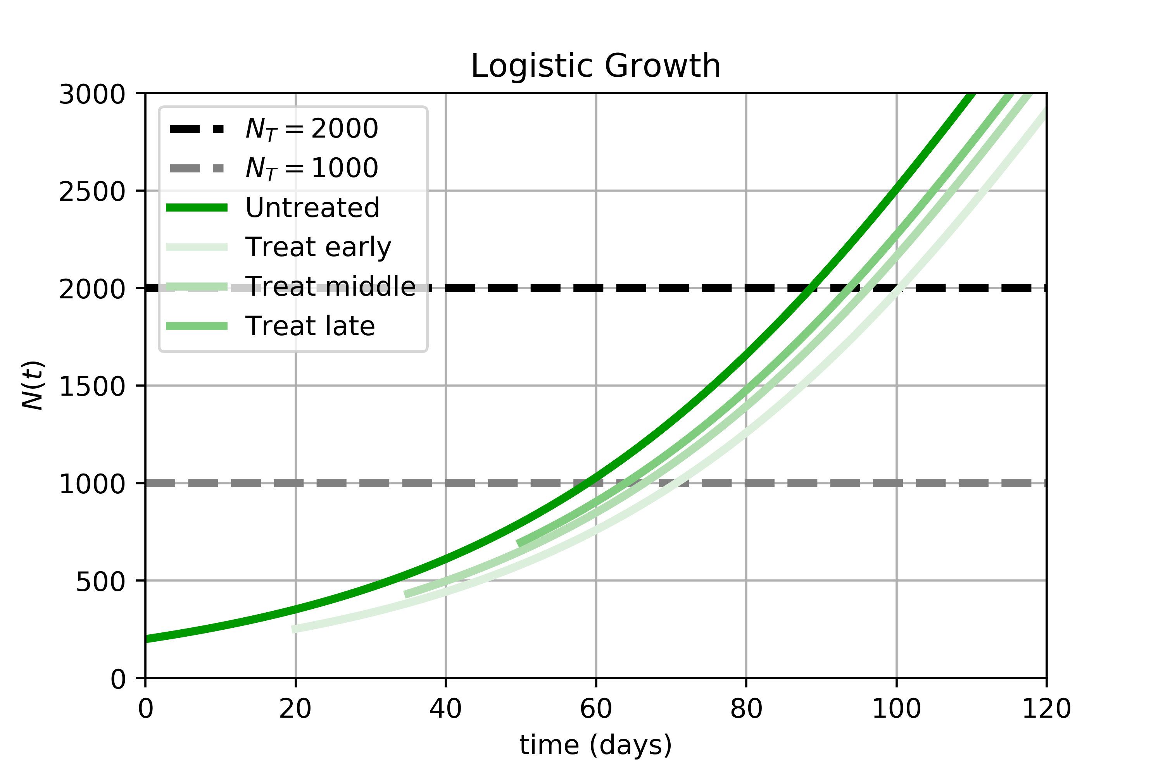
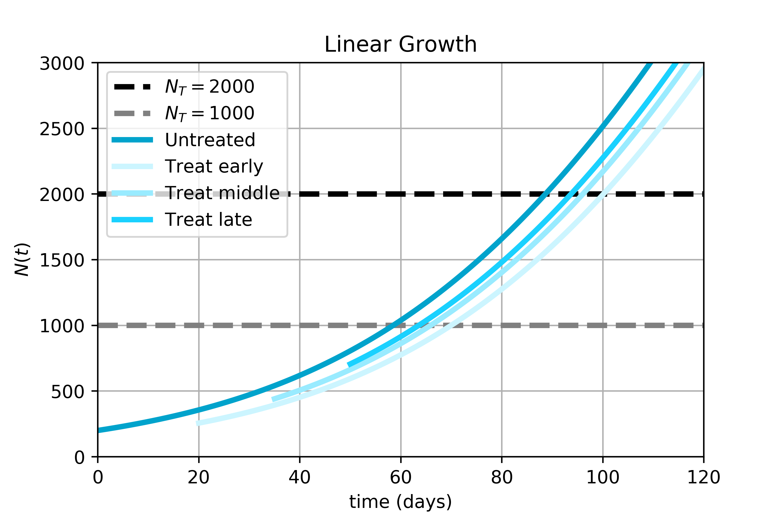
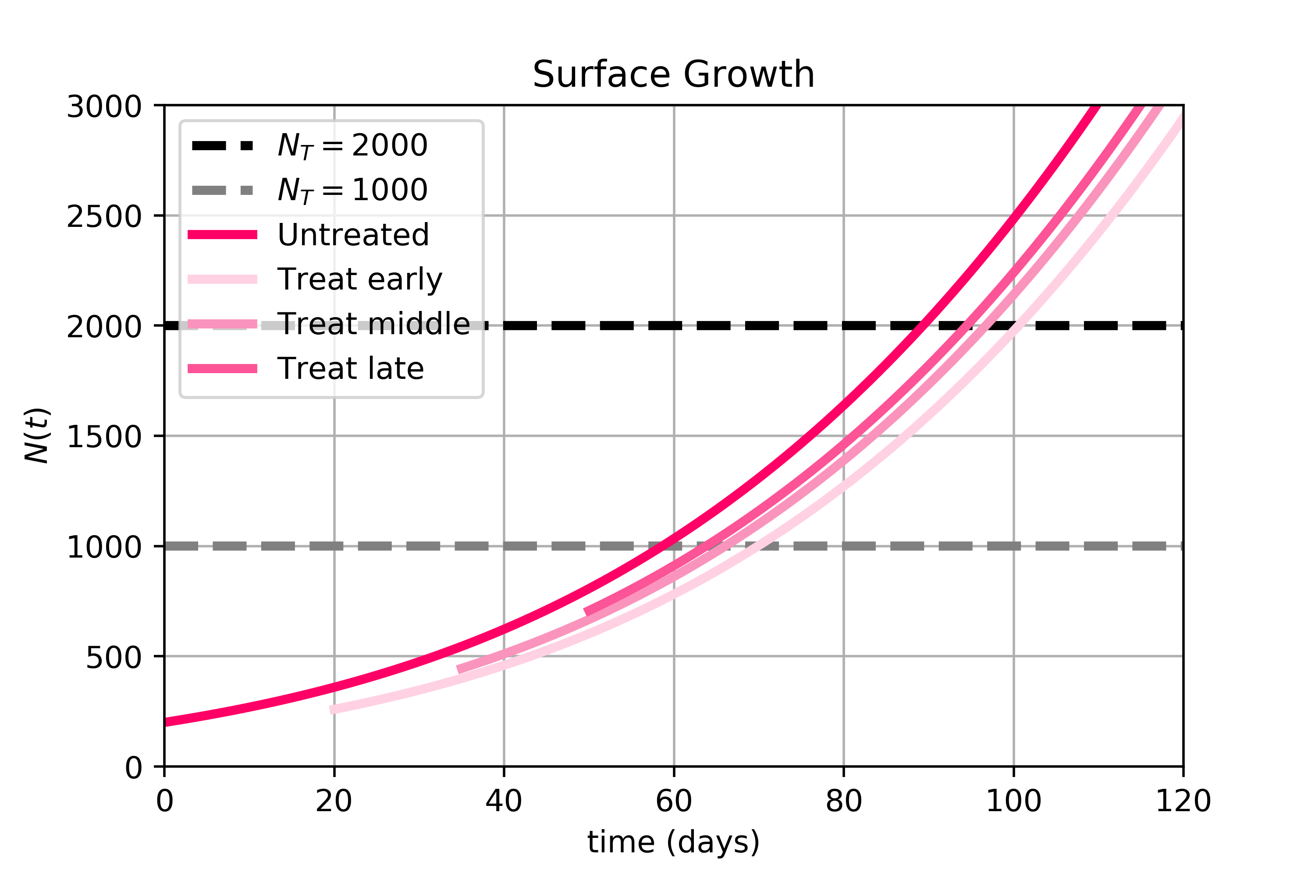
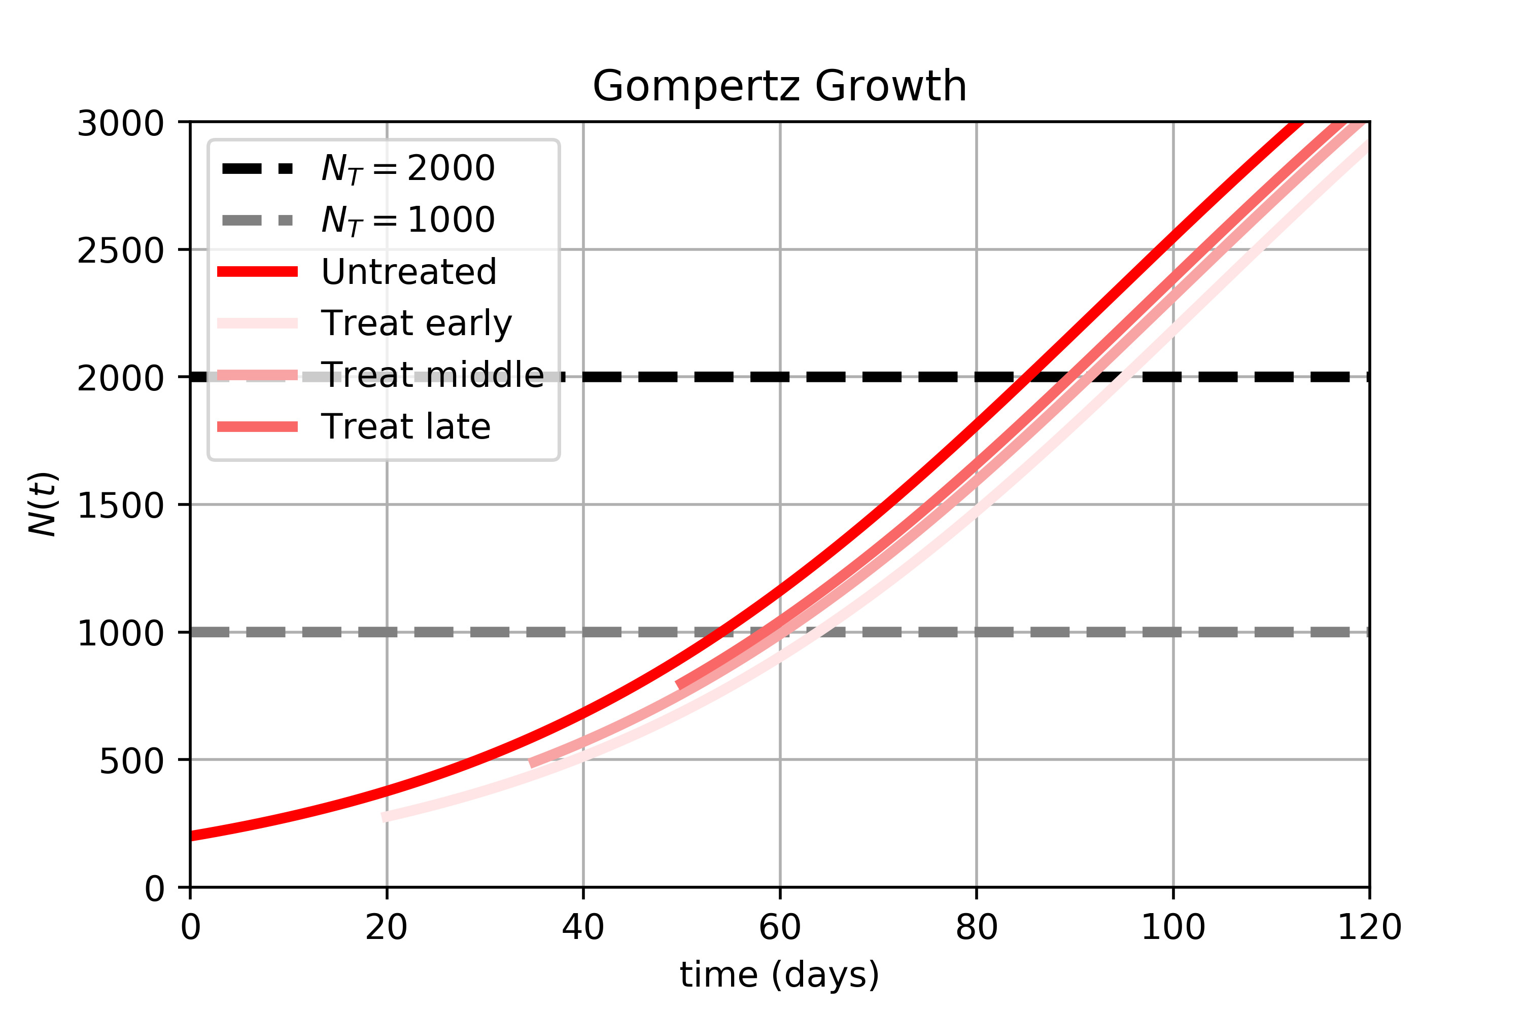
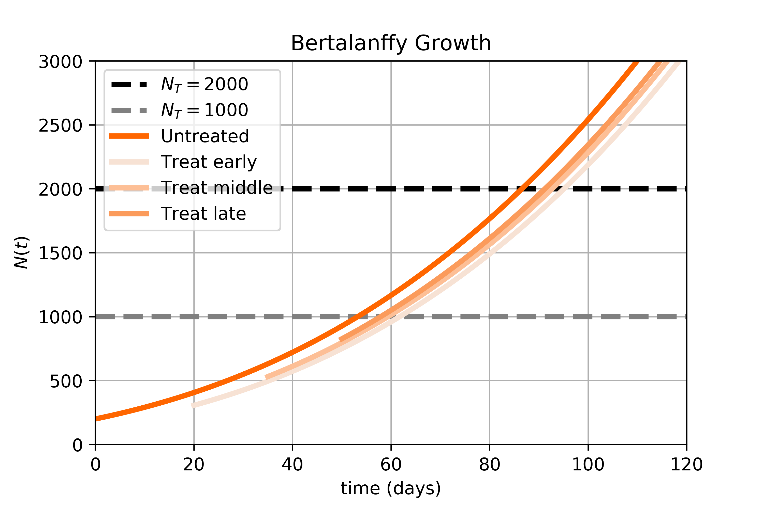
A.
B.
C.
D.
E.
F.
G.
H.

Slide 9
N_{T} = 1000 | Treat Early Δ_{t} | Treat Middle Δ_{t} | Treat Late Δ_{t}
Exponential | 14.83 | 9.65 | 6.42
Mendelsohn | 10.23 | 7.03 | 5.07
Logistic | 11.82 | 7.56 | 5.10
Linear | 11.49 | 7.42 | 5.07
Surface | 11.26 | 7.41 | 5.16
Gompertz | 9.85 | 6.27 | 4.36
Bertalanffy | 8.53 | 6.14 | 4.67
N_{T} = 2000 | Treat Early Δ_{t} | Treat Middle Δ_{t} | Treat Late Δ_{t}
Exponential | 14.83 | 9.65 | 6.42
Mendelsohn | 10.23 | 7.03 | 5.07
Logistic | 11.82 | 7.56 | 5.10
Linear | 11.49 | 7.42 | 5.07
Surface | 11.26 | 7.41 | 5.16
Gompertz | 9.85 | 6.27 | 4.36
Bertalanffy | 8.53 | 6.14 | 4.67

Slide 10
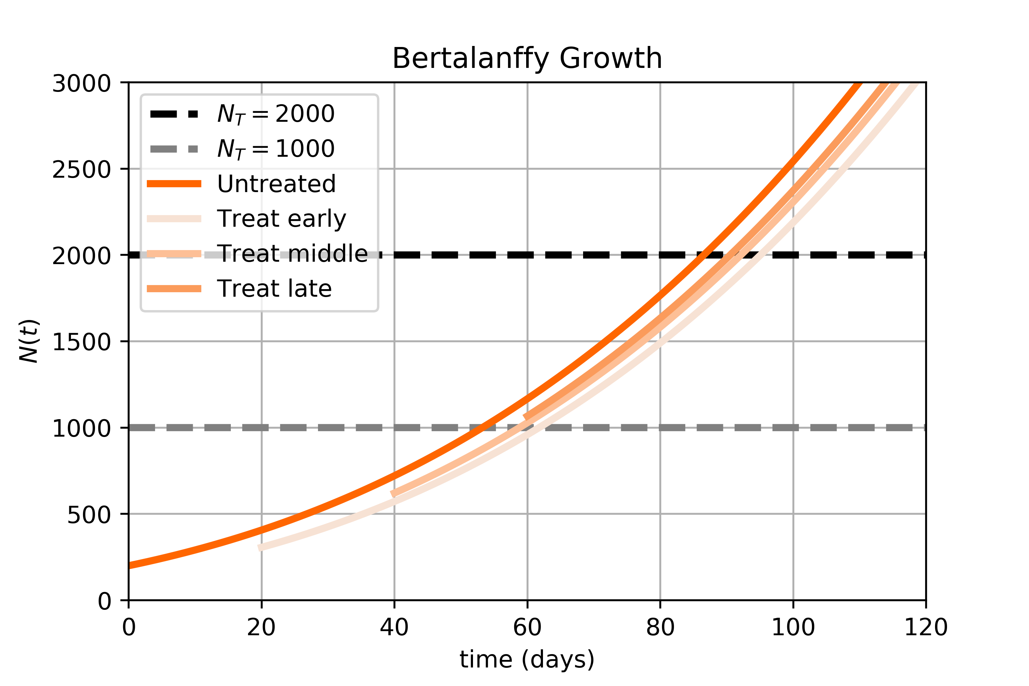
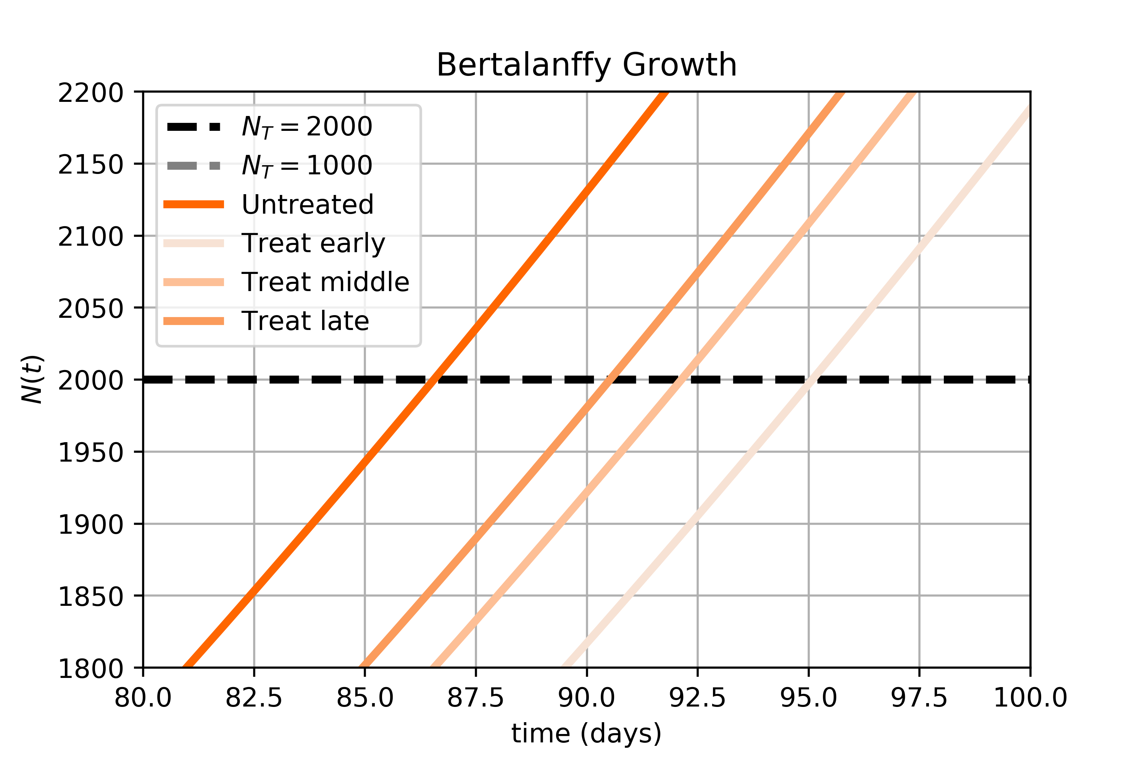
Δt₃
Δt₂
Δt₁

